Slide 1
HandsMen Threads: Elevating the Art of Sophistication in Men's Fashion
Salesforce Project Documentation

Slide 2
1. Project Phases
Phase 1: Architecture & Planning
Define objects, fields, relationships, formula fields.
Establish validation rules, flows, Apex triggers, batch jobs.
Design email templates for notifications and customer communication.
Phase 2: Development
Object and field creation.
Implement automation (flows, process builders, Apex triggers).
Set up data security and sharing rules.
Develop batch jobs for scheduled processing.
Configure email templates and notifications.
Phase 3: Testing & QA
Unit testing of objects and automation.
End-to-end testing with sample data.
Performance testing and security checks.
Phase 4: Deployment & Training
Deploy to production.
Train users on new functionality.
Post-go-live support and monitoring
Deliverable: Solution Design Document including Object Model, ERD, and Automation Strategy.

Slide 3
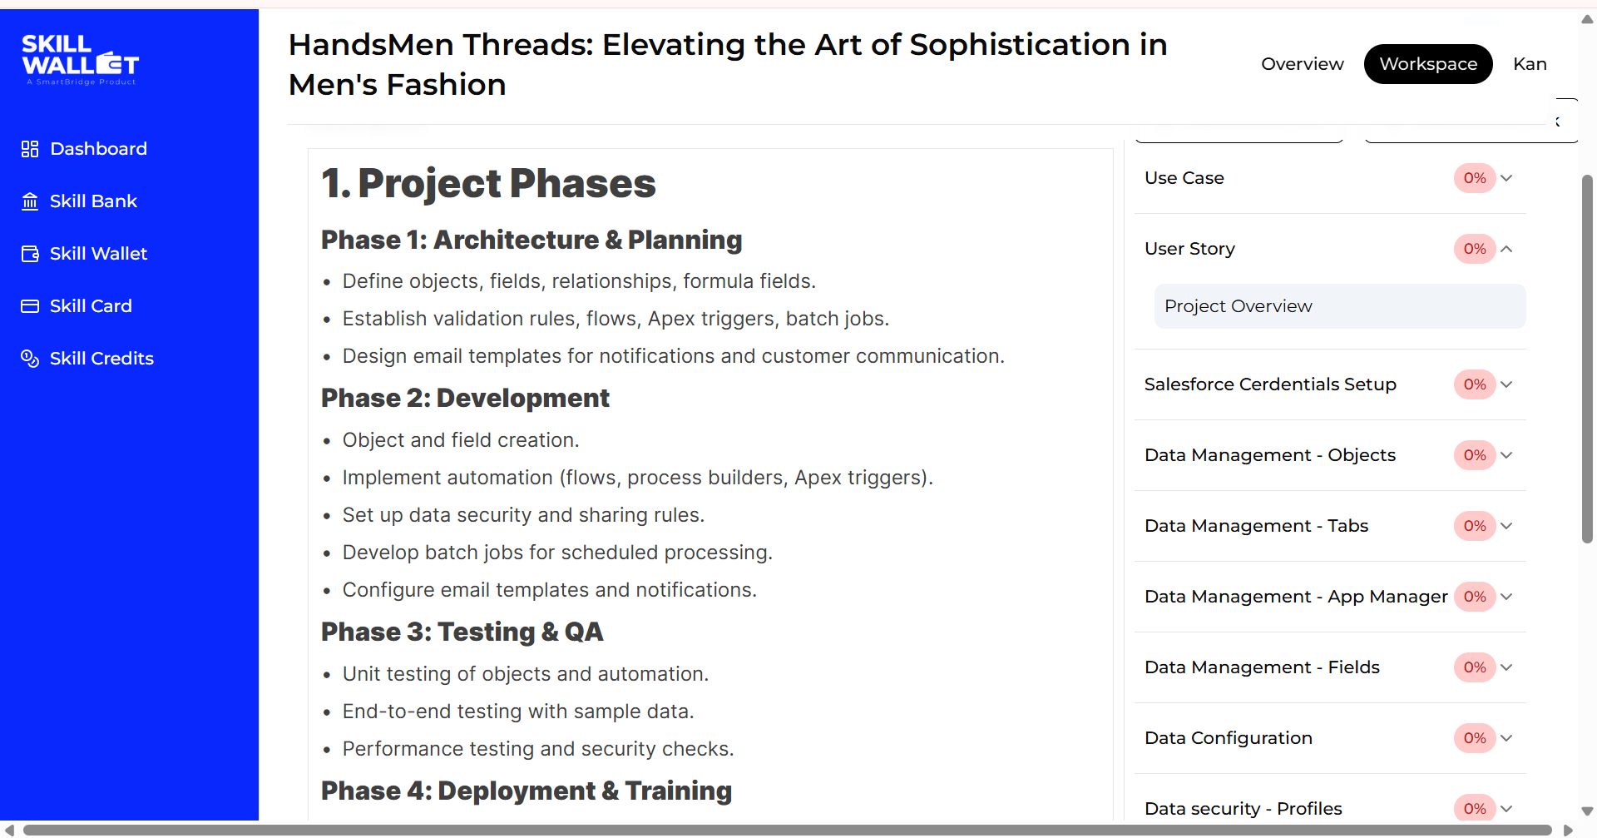
First name & Last name
Email
Role : Developer
Company : College Name
County : India
Postal Code : pin code
Username : should be a combination of your name and company
This need not be an actual email id, you can give anything in the format : username@organization.com
Cl

Slide 4
Creating Developer Account
Creating a developer org in salesforce.
Go to https://developer.salesforce.com/signup
On the sign up form, enter the following details :
First name & Last name
Email
Role : Developer
Company : College Name
County : India
Postal Code : pin code
Username : should be a combination of your name and company
This need not be an actual email id, you can give anything in the format : username@organization.com
Account Activation
Go to the inbox of the email that you used while signing up. Click on the verify account to activate your account. The email may take 5-10mins

Slide 5
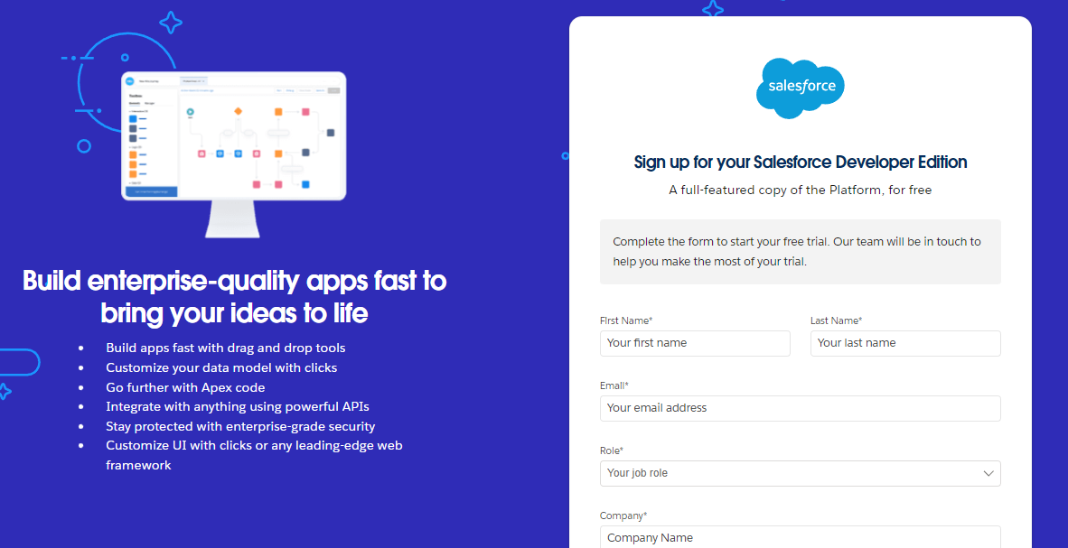

Slide 6
Data Management - Objects
Description
The following are the Custom objects which we need to create
HandsMen Customer
HandsMen Order
HandsMen Product
Inventory
Marketing Campaign
Create a Lightning App
To create a lightning app page:
Go to setup page → search “app manager” in quick find → select “app manager” → click on New lightning App.
Fill the app name in app details and branding as follow App Name : HandsMen Threads Developer Name : this will auto populated Description : Give a meaningful description Image : optional (if you want to give any image you can otherwise not mandatory) Primary color hex value : keep this default
Then click Next → (App option page) keep it as default → Next → (Utility Items) keep it as default → Next.

Slide 7
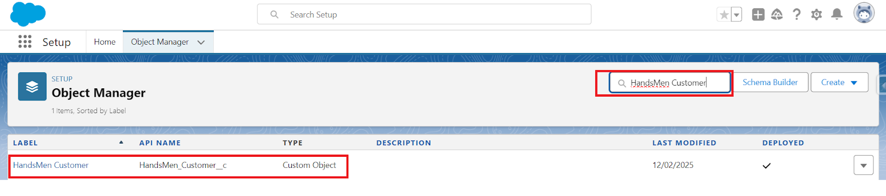
Search the items in the search bar(HandsMen Customer, HandsMen Order, Inventory, HandsMen Product, Reports, Dashboard, Account, Contact , Marketing Campaign) from the search bar and move it using the arrow button → Next. Note: select the custom object which we have created in the previous activity.
Creating Field in HandsMen Customer Object
To create fields in an object:
Go to setup → click on Object Manager → type object name(HandsMen Customer) in quick find bar→ click on the object.

Slide 8
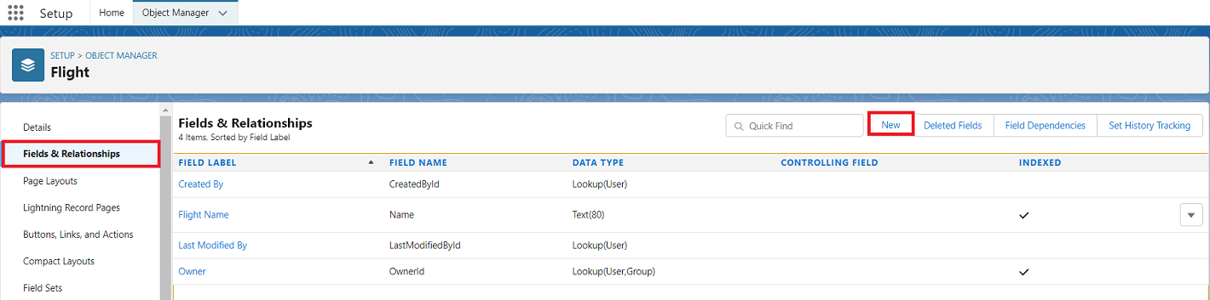
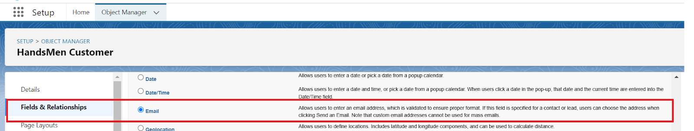
Now click on “Fields & Relationships” → New
Select Data type as “Email”.

Slide 9
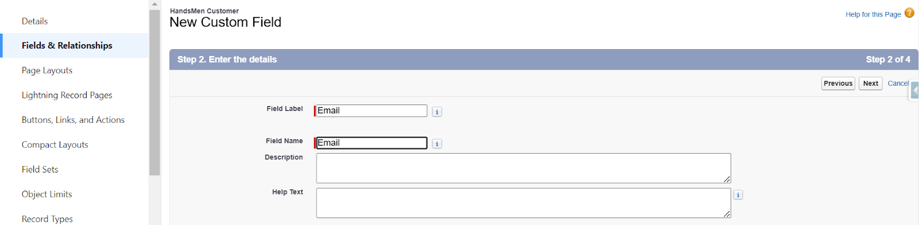
Click on Next
Fill the above as following:
Field Label: Email
Field Name : gets auto generated
Click on Next → Next → Save and new.

Slide 10
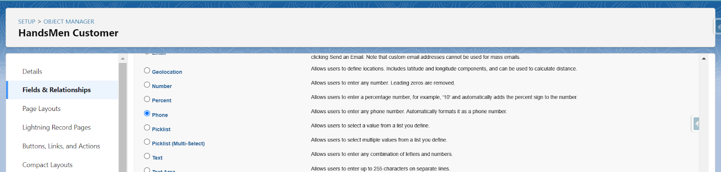
Creating Phone on HandsMen Customer Object
Go to setup → click on Object Manager → type object name(HandsMen Customer) in quick find bar→ click on the object.
Now click on “Fields & Relationships” → New.
Select Data type as “Phone” and click Next.

Slide 11
Click on Next.
Fill the above as following:
Field Label: Phone.
Field Name : gets auto generated.
Click on Next → Next → Save and new.
Creating Picklist field on HandsMen Customer object.
Go to setup → click on Object Manager → type object name(HandsMen Customer) in quick find bar→ click on the object.
Now click on “Fields & Relationships” → New.
Select Data type as “Picklist” and click Next.
Enter Field Label as “Loyalty Status”, under values select “Enter values, with each value separated by a new line" and enter values as shown below:
Gold
Silver
Bronze

Slide 12
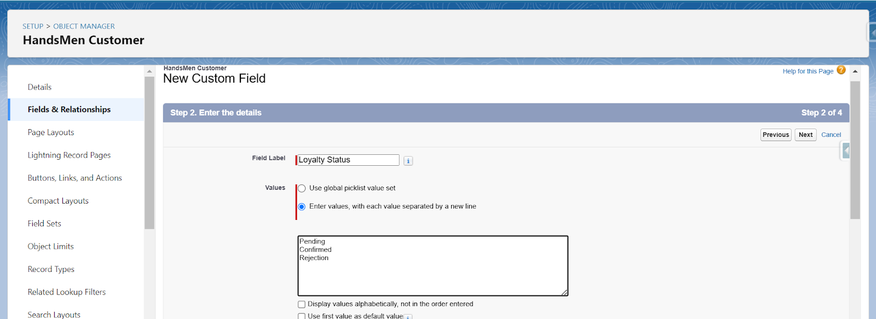
Click Next→ Next → Next → Save & New.
Unit 1 : Creating Lookup Relationship between Marketing Campaign and HandsSome Customer
To Create a lookup relationship
Go to the setup page → click on object manager → type object name(Marketing Campaign) in the quick find bar→ click on the object.
Click on fields & relationship → click on New.
Select “lookup relationship” as data type and click Next.
For field label related to: select “HandsMen Customer” object and click Next.
Give Field Label as “HandsMen Customer” and click Next.
Next → Next → Save.

Slide 13
Unit 2 : Creating Lookup Relationship between HandsMen Product and HandsMen Order
To Create a lookup relationship
Go to the setup page → click on object manager → type object name(HandsMen Product) in the quick find bar→ click on the object.
Click on fields & relationship → click on New.
Select “lookup relationship” as data type and click Next.
For field label related to: select “HandsMen Order” object and click Next.
Give Field Label as “Order” and click Next.
Next → Next → Save.
Unit 3 : Creating Lookup Relationship between HandsMen Order and HandsMen Customer
To Create a lookup relationship
Go to the setup page → click on object manager → type object name(HandsMen Order) in the quick find bar→ click on the object.
Click on fields & relationship → click on New.
Select “lookup relationship” as data type and click Next.
For field label related to: select “HandsMen Customer” object and click Next.
Give Field Label as “Customer” and click Next.
Next → Next → Save.

Slide 14
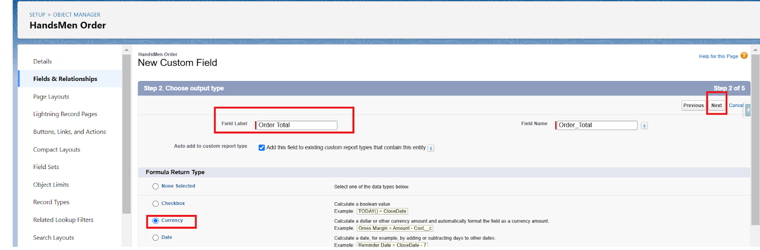
Unit 4 : Creating Master-Detail Relationship between Inventory and HandsSome Product
To Create a Master-Detail relationship
Go to the setup page → click on object manager → type object name(Inventory) in the quick find bar→ click on the object.
Click on fields & relationship → click on New.
Select “Master-Detail relationship” as data type and click Next.
For field label related to: select “HandsMen Product” object and click Next.
Give Field Label as “Product” and click Next.
Next → Next → Save.

Slide 15
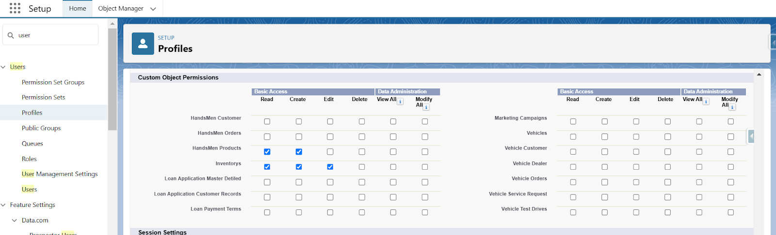
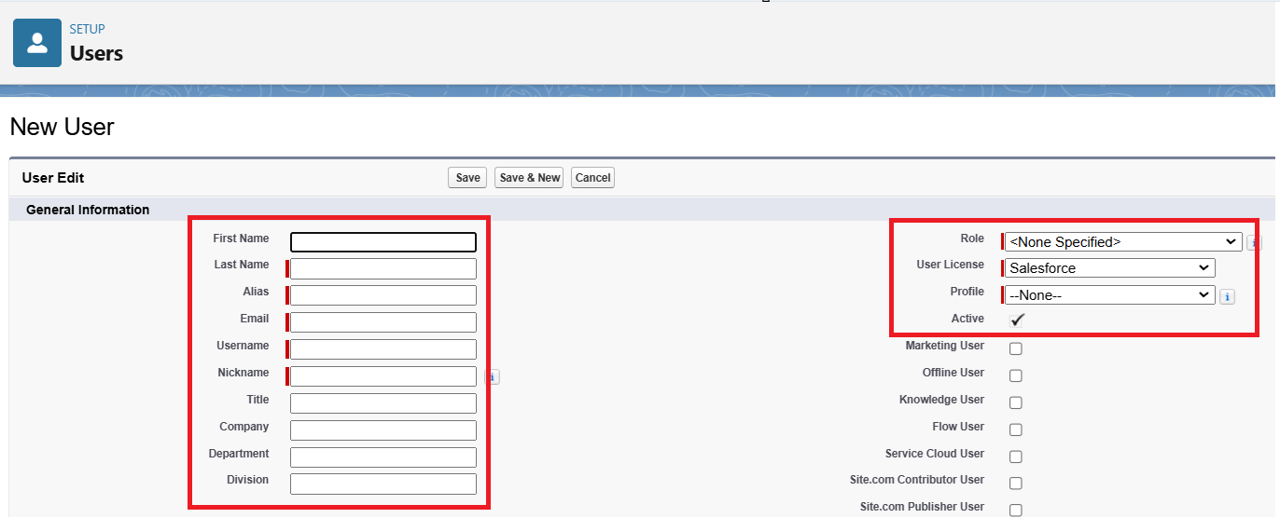
Creating Profile
Create User

Slide 16
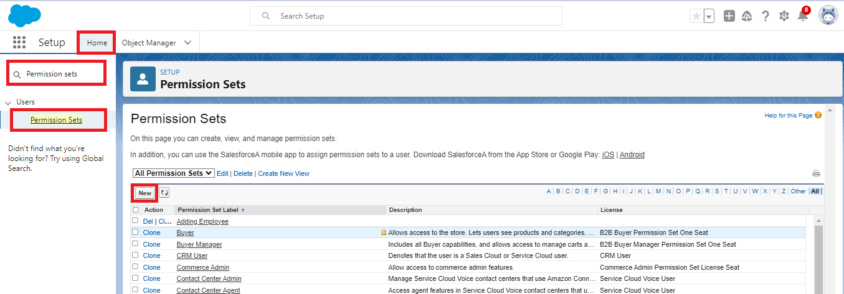
Permission set - Permission_Platform_1
Steps to Create a Classic Email Template
Go to Salesforce Setup
Click on the Gear Icon (⚙) in the top-right corner and select Setup.
Navigate to Classic Email Templates
In Quick Find, seClick "arch for Classic Email Templates and click on it.
New Template"

Slide 17
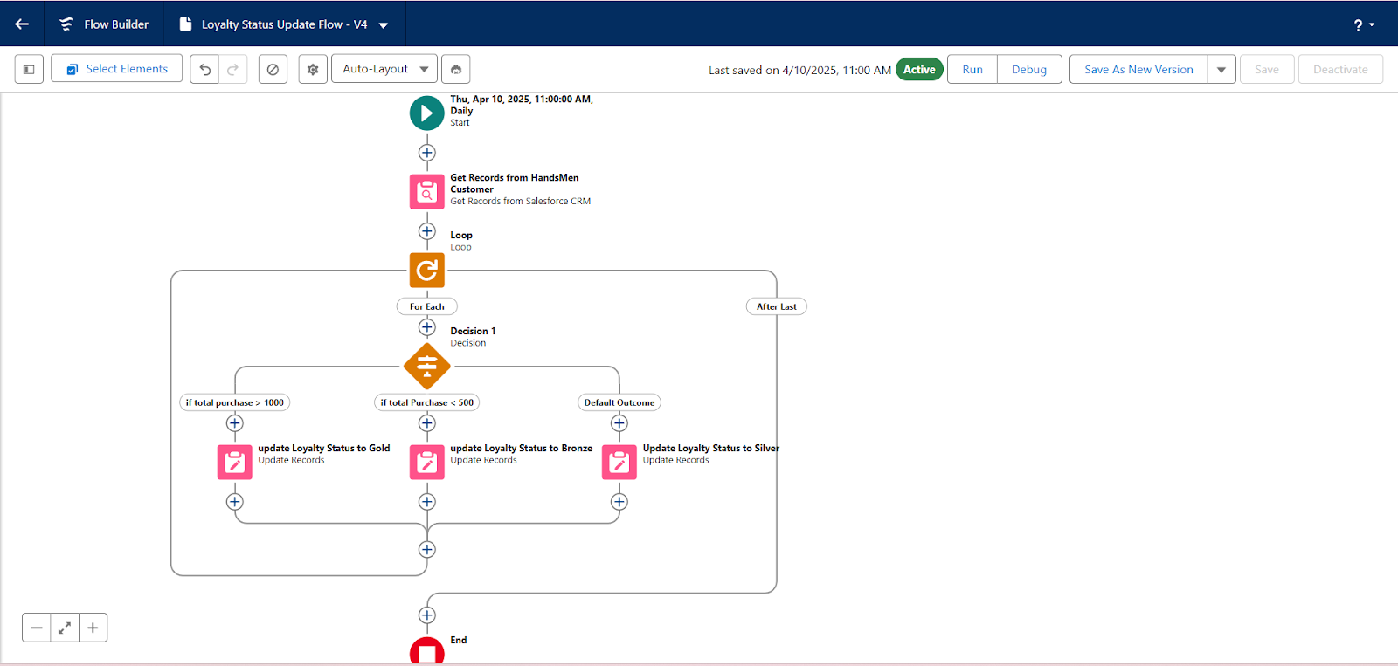
Loyalty Status Update (Scheduled Flow)

